Slide 1
Introduction Honours Programme FHML
Theo de Kok & Juanita Vernooy - Coordinators
May 21, 2024
Maastrichtzaal 18:30 – 20:30

Slide 2
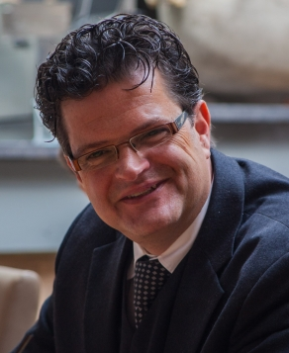
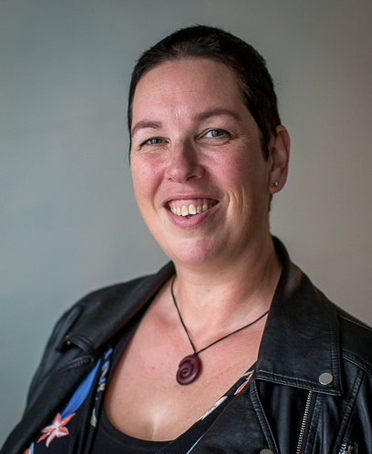
Information for potential participants
May 21st, 2024
18.30 – 20.30 hours
Maastrichtzaal
Theo de Kok (chair)
Juanita Vernooy (vice-chair)

Slide 3
Agenda
18.30 Theo de Kok Welcome
An overview of the FHML Honours Programme
Projects & competences
19.00 Juanita Vernooy Elective courses
Application and selection
19.15 MAAHS Presentation
19.30 Honours+ Presentation
19.40 Questions from the audience
20.15 Closure

Slide 4
Agenda
18.30 Theo de Kok Welcome
An overview of the FHML Honoursprogramme
Projects & competences
19.00 Juanita Vernooy Elective courses
Application and selection
19.15 MAAHS Presentation
19.30 Honours+ Presentation
19.40 Questions from the audience
20.15 Closure

Slide 5
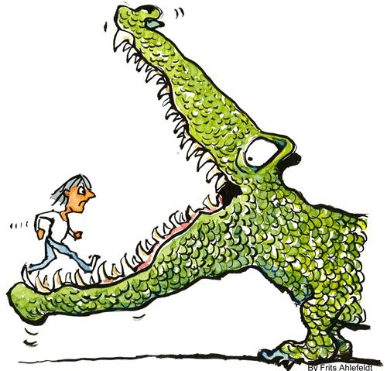
Objectives of the Honours Programme
To challenge you and all other students of FHML
To step out of your confort zone
To get involved with students from other disciplines
To work on a CV that stands out of the ordinary
To take control over your own research project
To work on a personalized set of competencies

Slide 6
General features of the Honours Programme
Open for students from ALL programmes within FHML
Project based approach:
opportunities for initiative, creativity, networking, no easy going learning
Relevant and real-life outcomes
Personalized tasks and compentency development
Budget responsibilities
Specific endproduct is not necessarily a report
3. Elective Courses and lectures:
Addressing historical, ethical and philosophical issues
Academic skills and competencies

Slide 7
Structure & study load FHML-HP
Starting mid September 2024, ending early April 2026
15 EC = 420 hours during 18 months (equivalent)
Two elements: Project (9 EC) & Courses (6 EC)
Regular project meetings with or without your coach; mostly outside regular study hours
Dedicated time slot once a month Wednesday 16.00-18.00 hours

Slide 8
Projects and competences in practice
What happens if I am admitted to the Honours Programme?
We have 8-10 different types of projects
You apply for a project and a specific “position”
You will identify your own strong and weaker competencies
Your profile will be matched against the project
You will define with your coach a “learning-working” agreement
Everybody has a personalized work plan
Everybody will be tailor-made graded

Slide 9
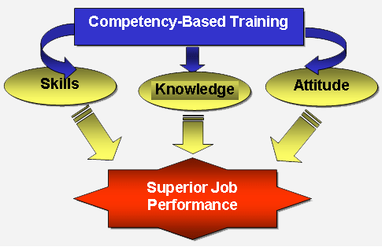
What are competencies?
Combination of Knowledge, Skills and Attitudes
Being proactive, optimistic, motivating, problems solving, critical to others, constructive ….

Slide 10
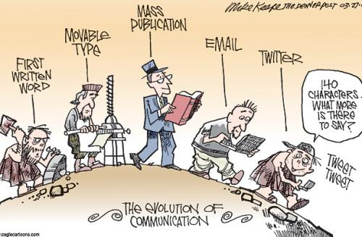
Competencies within the Honours Programme
Competence map with 3 main categories:
Project-based and result-oriented collaboration
Research and analytical competencies
Communicative competencies
Each category has 3-4 subcategories with specific criteria

Slide 11
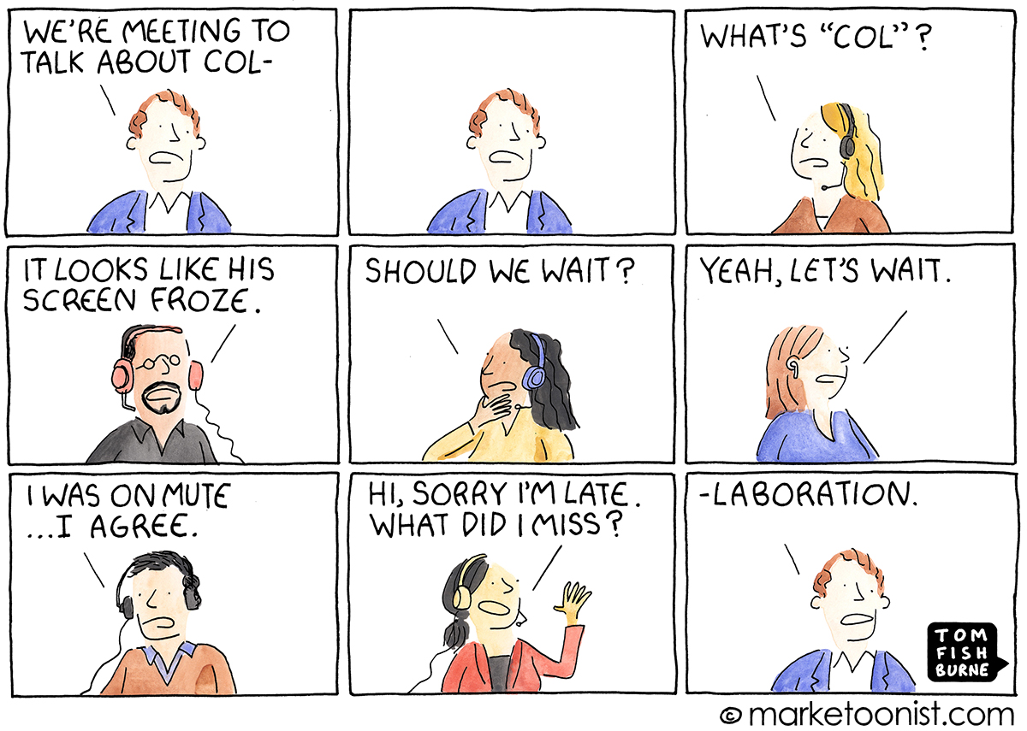
Example category 1: Collaboration
1.1 Cooperating
Definition:
Contributing with other persons or groups to a joint result,
even when there is no direct personal interest in doing so.

Slide 12
Example category 1: Collaboration
1.1 Cooperating
Definition:
Contributing with other persons or groups to a joint result,
even when there is no direct personal interest in doing so.
Evaluation criteria:
- Shares information and experiences with others
- Offers colleagues help when they need it
- Contributes ideas, proposals and other input designed to achieve a group result
- Responds actively and constructively to the ideas of others
- Adapts to the group and its goals when a joint result is needed
- Bridges people’s differences and their different viewpoints

Slide 13
The ‘Learning-Working’ agreement
Everyone makes a selection of 3-4 competencies to work on
This will determine how the project work will be evaluated
Feedback on the competencies at given time points
Feedback from the coach as well as project group members

Slide 14
The Honours projects (9 EC - 252 hours)
Research project with 6-8 other students under the supervision of a FHML staff member
A specific topic in health care, life sciences or medicine
Mostly connected to a company or an institution in health care

Slide 15
Anticipated Projects 2024
Dr. S. Linden (Dept. Health, Ethics and Society)
Brain control – patients’ attitudes to (closed-loop) deep brain stimulation
Prof. Dr. T. de Kok (Dept. Toxicogenomics)
Oncological Research Landscape South Limburg – ONCOS
Dr. A. Wind (Dept. Precision medicine)
Developing a transdisciplinarity governance framework for (one) health
Dr. C. Mota (Dept. Complex Tissue Regeneration at MERLN)
Developing a Kidney app
Dr. M. Knibbe (Dept. Health, Ethics and Society)
Designing healthy cities
Prof. dr. B. Smeets (Dept. Toxicogenomics)
Muscle regeneration (*)
Dr. Masoud Zamani Esteki (Dept. Clinical Genetics)
PREhealth digital school to enhance reproductive literacy through AI (*)

Slide 16
Project 1. Brain control: Patients’ attitudes to (closed-loop) deep brain stimulation
Project coach: Dr. S. Linden (Dept. Health, Ethics and Society)
Commissioner: The Brain and Nerve Centre of the MUMC
Research question: What are the experiences of patients about living with an implanted brain stimulation device that adjusts itself.
Rationale:
Deep brain stimulation (DBS) is an innovative neuromodulation treatment
More than 200,000 patients have been treated worldwide
Very labor intensive
Closed-loop systems, which automatically adjust stimulation could be more efficient and effective.
Investigation needed on what it would be like to live with such a self-adjusting neurostimulator.

Slide 17
Project 1. Brain control: Patients’ attitudes to (closed-loop) deep brain stimulation
Assignment
• To develop a questionnaire for DBS patients about their experiences
• Inventory of pro’s and con’s of closed-loop systems
• To conduct a survey of DBS patients from Maastricht
• To roll out the survey internationally to compare across countries/ cultural backgrounds
Outcome
• A publication on patient views on closed-loop DBS
• Presentation at EURO-DBS conference 2025
• A one-day workshop for clinicians, researchers and patients on closed-loop DBS

Slide 18
Project 2. ONCOS: Oncological Research Landscape South Limburg
Project coach: Prof. dr. T. de Kok (Dept. Toxicogenoimics)
Commissioner: ONCOS student working group / GROW oncology
Research question: To create a research landscape of oncology research in South-Limburg and present potential possibilities for inter-institutional/intra-institutional collaboration, whereby researchers as well as students can benefit.
Rationale:
Many stakeholders are involved in oncology research, but an overview is lacking.
This is limiting an efficient collaboration between departments and institutions.
It is also limiting student access to research internships and a global perspective
on oncological research.

Slide 19
Project 2. ONCOS: Oncological Research Landscape South Limburg
Assignment
To create a research landscape of oncology research in South-Limburg and present potential possibilities for inter-institutional/intra-institutional collaboration, whereby researchers as well as students can benefit.
Key research questions:
• Who are the stakeholders involved (institutes, hospitals, university, etc.)?
• Which research departments are involved at UM and outside?
• Which ongoing studies exist?
Outcome
A description of the oncology research landscape in a structured and organized overview (portal/website) accessible to researchers as well as students.

Slide 20
Agenda
18.30 Theo de Kok Welcome
An overview of the FHML Honoursprogramme
Projects & competences
19.00 Juanita Vernooy Elective courses
Application and selection
19.15 MAAHS Presentation
19.30 Honours+ Presentation
19.40 Questions from the audience
20.15 Closure

Slide 21
The calendar of the Honours Programme
Divided in four periods:
Three weeks of introduction Oct 2024
Project and Elective Courses Nov 2024 – Jan 2026
Finishing off project Jan 2026 – Mar 2026 (report, presentation, article, etc)
Closing Ceremony: presenting results Apr 2026
Extra opportunity:
- Start UM Honours+ Nov 2024
- Finish UM Honours+ May 2025

Slide 22
Elective Courses (6 EC - 140 hours)
Objectives:
Expanding your intellectual horizon
Out of your comfort zone
Gaining specific academic skills
Study load:
You need to obtain (at least) 6 EC: 1 EC = 28 study hours
1 EC: Mandatory course Discover your Competencies
4 EC: You can choose from a panel of Electives Courses
1 EC: Attend 5 scientific lectures to obtain 5 Lecture Points
Participating in UM-wide Honours+ Programme means exemption from 3 EC Elective courses

Slide 23
Examples of Elective Courses (1)
Entering the world of the Scientists (2 EC)
- in collaboration with FASOS
Reading books in History and Philosophy of HML (2 EC)
- reading & in depth discussion about a specific topic
Science for Society (1 EC)
- organizing a discussion evening for general public about a specific topic
Pint of Science (1 EC)
- organising a pub-event bringing science to the public
Qualitative Research (1 EC)
- ins and outs about qualitative research

Slide 24
Examples of Elective Courses (2)
Scientific Reporting and communicating (1 EC)
- how to use word, excel, powerpoint in scientific context
Scientific writing (1 EC)
- how to write & submit a scientific publication
Basic Introduction into Clinical Research (1 EC)
- ins and outs of submitting an METC application
SELF (1 EC)
- lecture series about Lifestyle and Food
Nominate an external course (max. 1 EC)
- send a request to the coordinators and receive credits

Slide 25
Selection procedure
The Honours Programme is open for all FHML students and students of Midwifery Education and Studies >> nominal study results
Students are admitted only if they:
can participate fully in the first three months of the programme and
can participate in the year 2024-2025 for at least 9 months* and
can participate in the final stage of the project in 2026
The coordinators of the Honours Programme are responsible for the selection of candidates
* Exceptions like a Minor abroad can be discussed

Slide 26
How to apply?
All students (except Midwifery*) send the application to
askfhml@maastrichtuniversity.nl or use the askfhml contact form
2. Enclose the following items:
Motivation letter (max 1.5 A4)
Curriculum vitae incl. skills
Transcript of the results of your 1st year of study
Contact details incl. Student ID-number & mobile phone number
* Students of the University of Midwifery Education and Studies can apply via: honoursfhml@maastrichtuniversity.nl

Slide 27
How to apply?
3. Deadline for application 21th of June 2024 at 23:59h
Provisional admittance will be announced in the 2nd week of July 2024
Final admittance or rejection will be announced at the end of August 2024 after receiving the results of the Board of Examiners

Slide 28
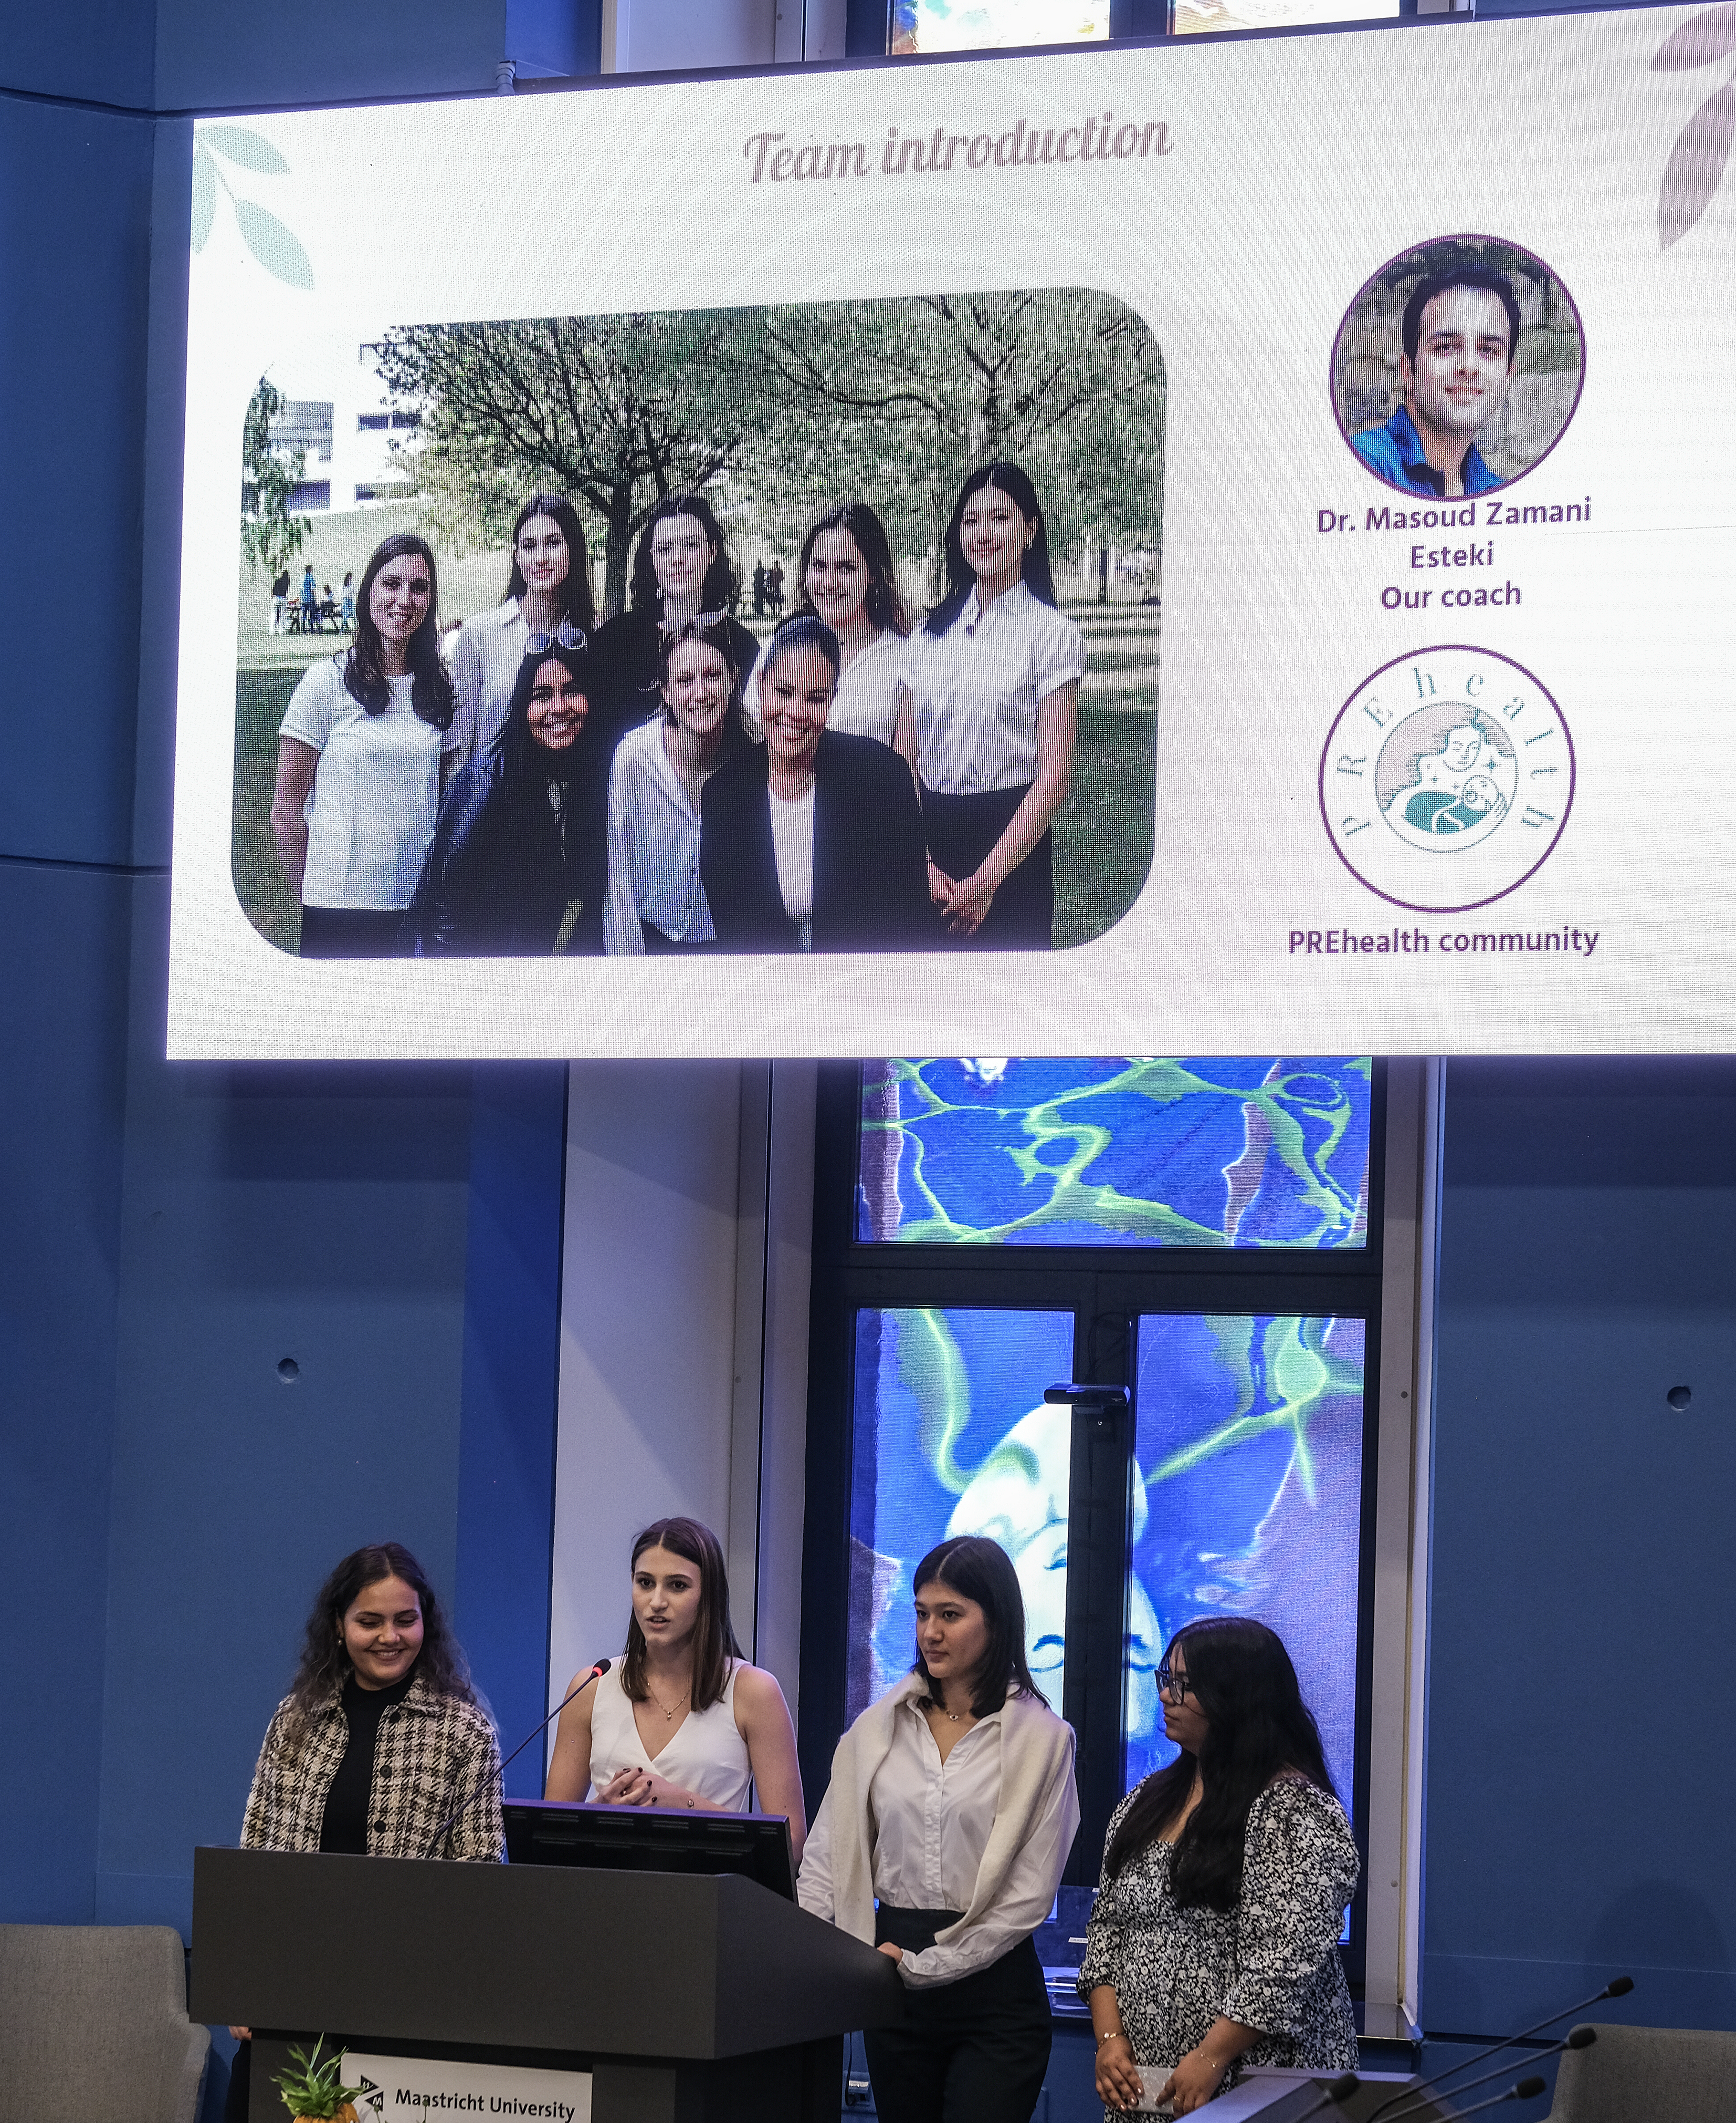
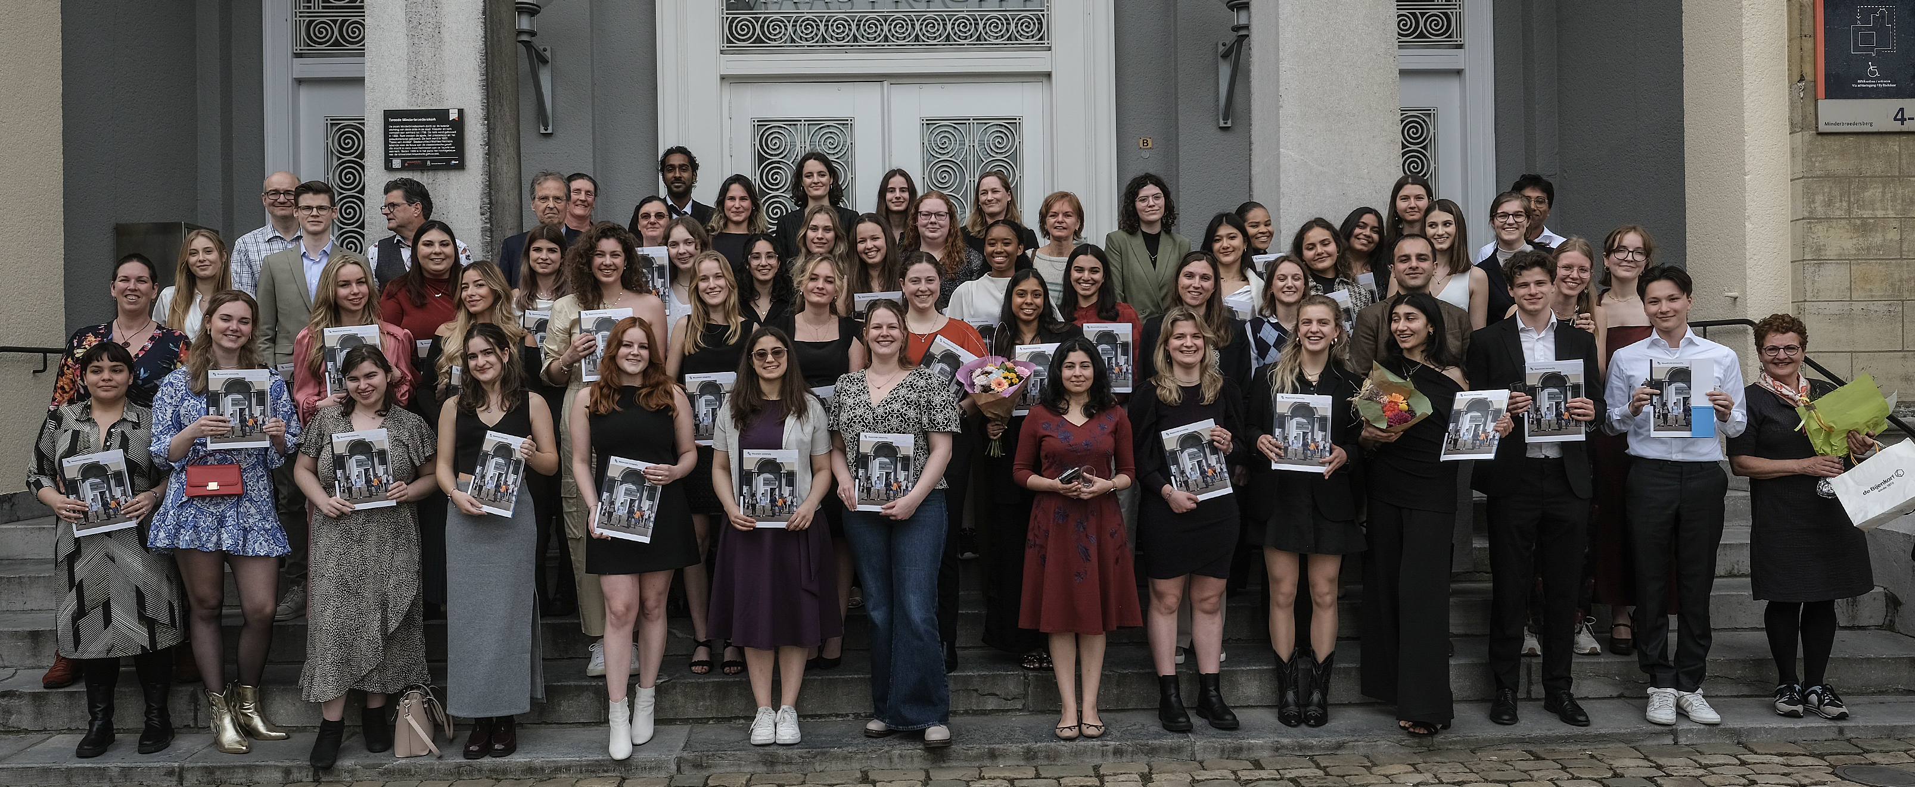
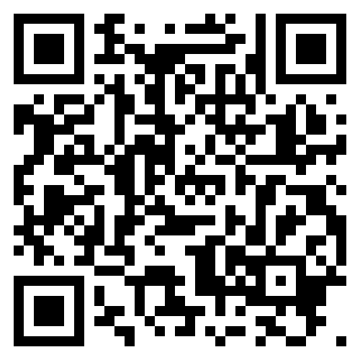
We challenge … YOU … to join the
Cohort 2022-2024

Slide 29
Agenda
18.30 Theo de Kok Welcome
An overview of the FHML Honoursprogramme 2023
Projects & competences
19.00 Juanita Vernooy Elective courses
Application and selection
19.15 MAAHS Presentation
19.30 Honours+ Presentation
19.40 Questions from the audience
20.15 Closure

Slide 30
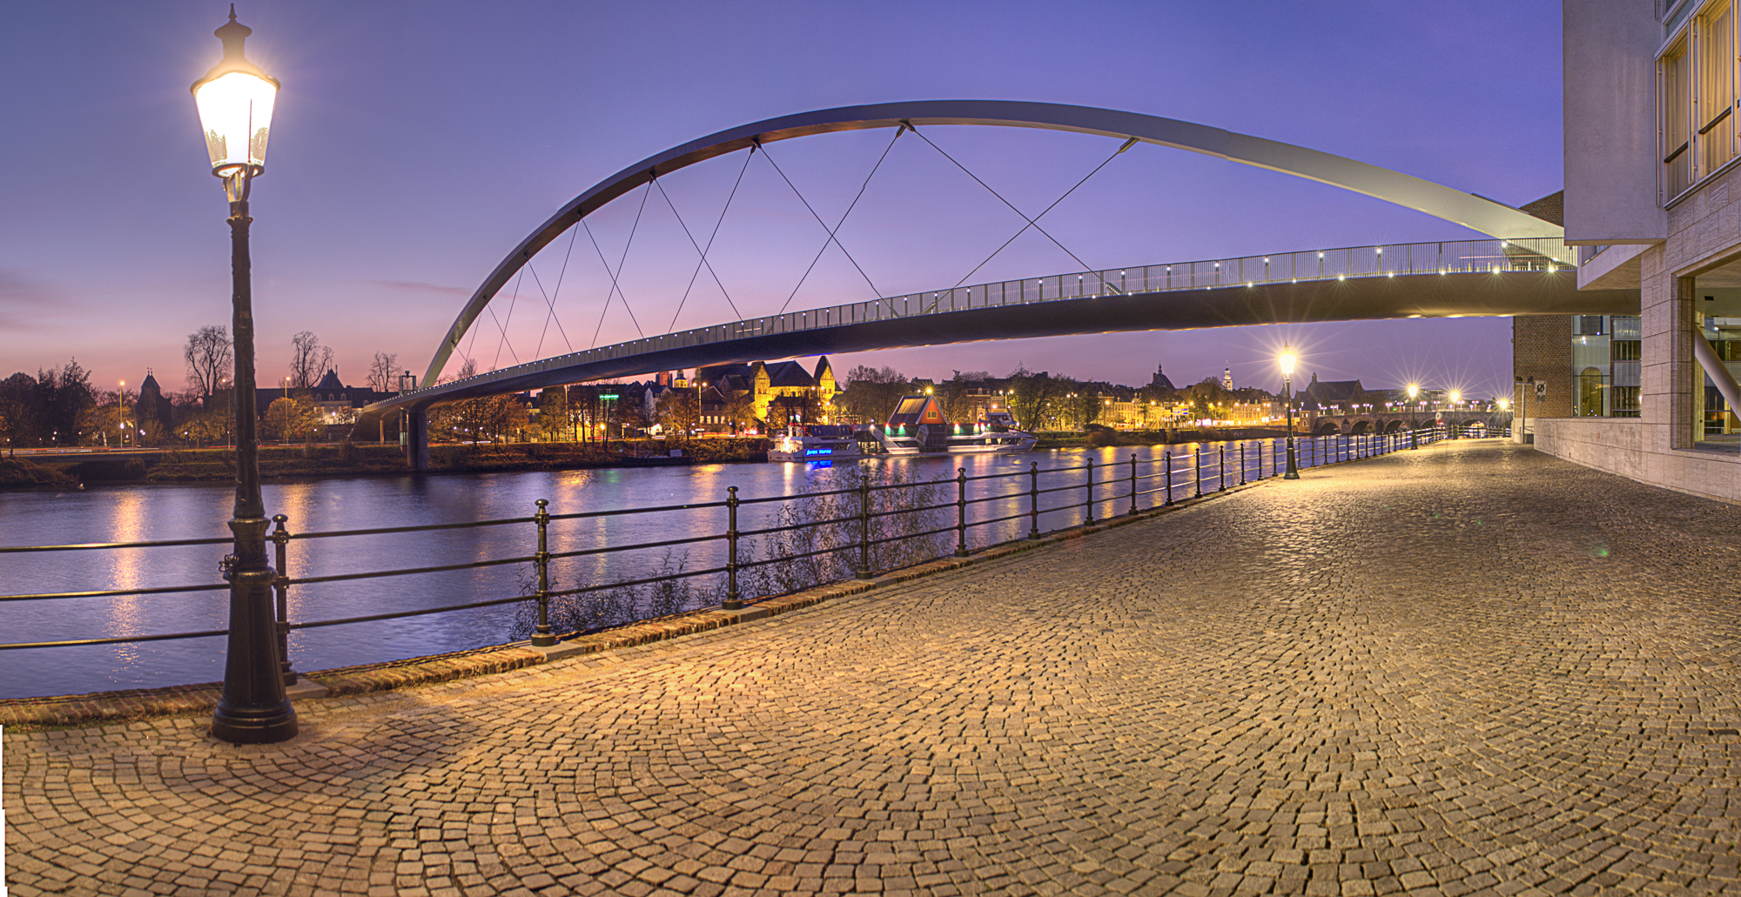
MAAHS
Maastricht Association of Alumni and Honours Students
You become a member!
Organizing fun and educational activities for all honours and alumni students:
Introduction period
Labtour
Pubquiz
Events
Graduation
… and much more!
E-mail: Maahs-fhml@maastrichtuniversity.nl
Facebook: MAAHSFHML
Notes:
Hello everyone and welcome to this info evening in the name of MA(A)HS! My name is Riva, I am on the board of MA(A)HS and I will give you a short introduction of who we are and what we do.

Slide 31
MAAHS
https://www.canva.com/design/DAGF1q5o_qE/eQJdOZWQiE_SV7snrReIgw/view?utm_content=DAGF1q5o_qE&utm_campaign=designshare&utm_medium=link&utm_source=editor
Notes:
Hello everyone and welcome to this info evening in the name of MA(A)HS! My name is Riva, I am on the board of MA(A)HS and I will give you a short introduction of who we are and what we do.

Slide 32
Agenda
18.30 Theo de Kok Welcome
An overview of the FHML Honoursprogramme 2023
Projects & competences
19.00 Juanita Vernooy Elective courses
Application and selection
19.15 MAAHS Presentation
19.30 Introduction UM-wide Honours+ Programme: https://www.youtube.com/watch?v=GpH5SUo4d0U
19.40 Questions from the audience
20.15 Closure

Slide 33
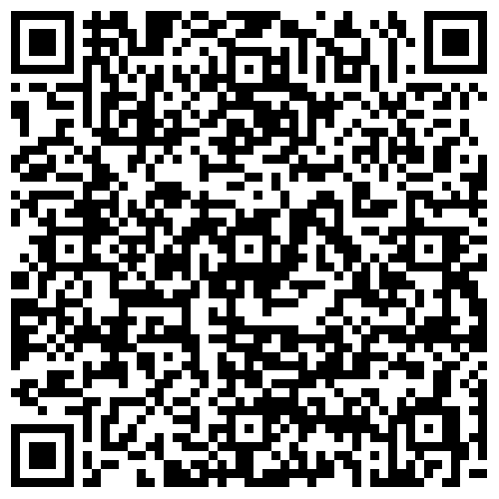
Agenda
18.30 Theo de Kok Welcome
An overview of the FHML Honoursprogramme
Projects & competences
19.00 Juanita Vernooy Elective courses
Application and selection
19.15 MAAHS Presentation
19.30 Honours+ Presentation
19.40 Questions from the audience
20.15 Closure

