Slide 2
PROGRAMMES & PROJECTS
Part-time international Executive Master in Finance & Control for Professionals
www.iemfc.eu (English)
MBA
EXECUTIVE MASTERS
MANAGEMENT PROGRAMMES
Parttime Opleiding tot Registercontroller
www.maastrichtRC.nl (Dutch)
Parttime Opleiding Bedrijfskunde
voor Professionals
www.maastrichtOBK.nl (Dutch)
CUSTOMISED PROGRAMMES FOR TEAMS & ORGANISATIONS
INNOVATION PROJECTS
Parttime Opleiding Business Control voor Professionals
www.maastrichtOBC.nl (Dutch)

Slide 3
THE SCIENCE OF
PERFORMANCE MANAGEMENT
Maastricht University Alumni Day
4 September 2021

Slide 4
What do you perceive as the single most
important goal of any organization?
Parttime Opleiding Bedrijfskunde voor Professionals
www.maastrichtOBK.nl

Slide 5
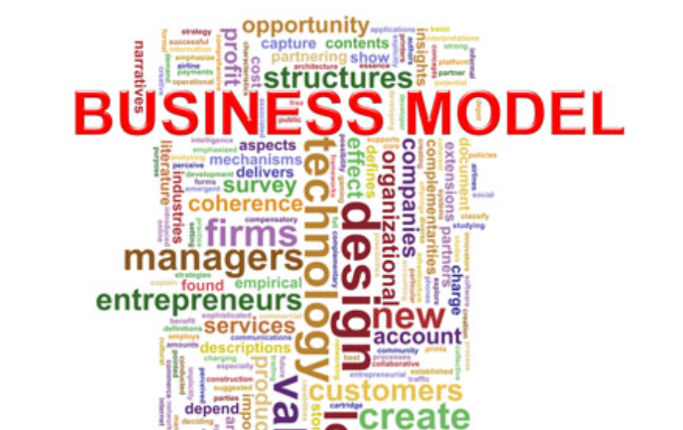
Parttime Opleiding Bedrijfskunde voor Professionals
www.maastrichtOBK.nl

Slide 6







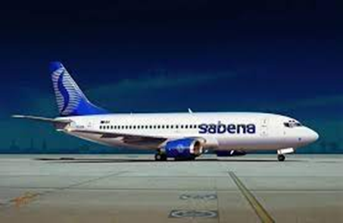
Parttime Opleiding Bedrijfskunde voor Professionals
www.maastrichtOBK.nl

Slide 7
How to keep your business model alive?
Parttime Opleiding Bedrijfskunde voor Professionals
www.maastrichtOBK.nl

Slide 8








Parttime Opleiding Bedrijfskunde voor Professionals
www.maastrichtOBK.nl

Slide 9
Peter Drucker on the Business Model:
Who is your customer, what does the customer value, and how do you deliver value at an appropriate cost?
Parttime Opleiding Bedrijfskunde voor Professionals
www.maastrichtOBK.nl

Slide 10

Parttime Opleiding Bedrijfskunde voor Professionals
www.maastrichtOBK.nl

Slide 11
STRATEGY
DEVELOPMENT
STRATEGY
EXECUTION
Parttime Opleiding Bedrijfskunde voor Professionals
www.maastrichtOBK.nl

Slide 12
THE PERFORMANCE MANAGEMENT SYSTEM AS THE KEY TO SUCCESS FOR ANY ORGANIZATION
Parttime Opleiding Bedrijfskunde voor Professionals
www.maastrichtOBK.nl

Slide 13
Several scientists have thought about structures and ways to increase the likelihood that organizations achieve their strategic goals.
This session provides an overview of a number of these theories and works towards a practical synthesis that can be used by organizations to critically analyze and improve their own performance management system.
Parttime Opleiding Bedrijfskunde voor Professionals
www.maastrichtOBK.nl

Slide 14
Performance Management System
Parttime Opleiding Bedrijfskunde voor Professionals
www.maastrichtOBK.nl

Slide 15
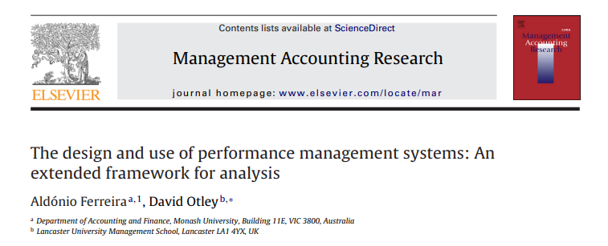
Parttime Opleiding Bedrijfskunde voor Professionals
www.maastrichtOBK.nl

Slide 16
Parttime Opleiding Bedrijfskunde voor Professionals
www.maastrichtOBK.nl

Slide 17
FERREIRA & OTLEY: FRAMEWORK FOR PERFORMANCE MANAGEMENT SYSTEMS (1)
    What is the vision and mission of the organization and how is this brought to the attention of managers and employees?
    What are the key factors that are believed to be central to the organization's overall future success and how are they brought to the attention of managers and employees?
Parttime Opleiding Bedrijfskunde voor Professionals
www.maastrichtOBK.nl

Slide 18
FERREIRA & OTLEY: FRAMEWORK FOR PERFORMANCE MANAGEMENT SYSTEMS (2)
What strategies and plans has the organization adopted and what are the processes and activities that it has decided will be required for it to ensure its success? How are strategies and plans generated and communicated to managers and employees?
What is the organization structure and what impact does it have on the design and use of the performance management and control system? How does it influence and how is it influenced by the process of strategy implementation?
Parttime Opleiding Bedrijfskunde voor Professionals
www.maastrichtOBK.nl

Slide 19
FERREIRA & OTLEY: FRAMEWORK FOR PERFORMANCE MANAGEMENT SYSTEMS (3)
What are the organization's key performance measures deriving from its objectives, key success factors, strategies and plans? How does the organization go about assessing and measuring its success in achieving them?
What level of performance does the organization need to achieve in each of the areas defined in the above question, and how does it go about setting appropriate performance targets for them?
Parttime Opleiding Bedrijfskunde voor Professionals
www.maastrichtOBK.nl

Slide 20
FERREIRA & OTLEY: FRAMEWORK FOR PERFORMANCE MANAGEMENT SYSTEMS (4)
What processes does the organization uses for evaluating individual, group, and organizational performance? How important is formal and informal information and controls on these processes? What are the consequences of the performance evaluation processes used?
What rewards (both financial and non-financial) will managers and other employees gain by achieving performance targets (or, conversely, what penalties will they suffer by failing to achieve them)?
Parttime Opleiding Bedrijfskunde voor Professionals
www.maastrichtOBK.nl

Slide 21
FERREIRA & OTLEY: FRAMEWORK FOR PERFORMANCE MANAGEMENT SYSTEMS (5)
What specific feedback and feed-forward information flows has the organization devised for itself? What sort of feedback information flows have been created for monitoring current performance and bringing about adaptation of current behavior? What type of feed-forward information flows (if any) have been formulated to enable the organization to learn from its experience, to generate new ideas and to recreate strategies and plans?
Parttime Opleiding Bedrijfskunde voor Professionals
www.maastrichtOBK.nl

Slide 22
FERREIRA & OTLEY: FRAMEWORK FOR PERFORMANCE MANAGEMENT SYSTEMS (6)
What type of use is made of feedback and feed-forward information flows and to the various control mechanisms in place? Is use predominately diagnostic, interactive, or a combination of both?
How has the performance management and control system changed in light of the change dynamics of the organization and of its environment? What changes have occurred at the level of those systems in anticipation or response to such stimuli?
Parttime Opleiding Bedrijfskunde voor Professionals
www.maastrichtOBK.nl

Slide 23
FERREIRA & OTLEY: FRAMEWORK FOR PERFORMANCE MANAGEMENT SYSTEMS (7)
How strong and coherent are the links between the components of the performance management and control system (as denoted by the above 11 questions)?
Parttime Opleiding Bedrijfskunde voor Professionals
www.maastrichtOBK.nl

Slide 24
Parttime Opleiding Bedrijfskunde voor Professionals
www.maastrichtOBK.nl

Slide 25
An Holistic View on Strategic Control
Parttime Opleiding Bedrijfskunde voor Professionals
www.maastrichtOBK.nl

Slide 26
CONTROL SYSTEMS FRAMEWORK
(ROBERT SIMONS – HARVARD BUSINESS UNIVERSITY)
Four types of control systems in organizations:
  Belief systems
  Boundary systems
  Diagnostic control systems
  Interactive control systems
Parttime Opleiding Bedrijfskunde voor Professionals
www.maastrichtOBK.nl

Slide 27
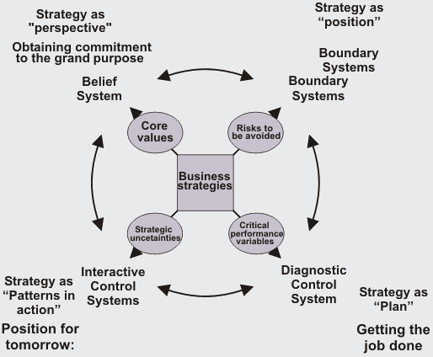
Parttime Opleiding Bedrijfskunde voor Professionals
www.maastrichtOBK.nl

Slide 28
BELIEF SYSTEMS
In the Levers of Control model, this lever determines the direction and concerns the mission and vision of the organisation. The mission must ensure that everyone within the organisation has enough intrinsic motivation to exude the values of the organisation.
While Diagnostic and Interactive Control Systems mainly focus on objectives, Beliefs and Boundary Systems focus on employee behaviour. The Belief Systems must encourage employees to look for opportunities for the organisation.
Their loyalty can be rewarded by extrinsic stimuli in the form of monetary rewards through targets and bonuses. The aim is for everyone within the organisation to display the desired behaviour. The Beliefs Systems formulate the basic values, standards, and beliefs of the organisation; this partly concerns the organisational culture.
Parttime Opleiding Bedrijfskunde voor Professionals
www.maastrichtOBK.nl

Slide 29
BOUNDARY SYSTEMS
  Boundaries for organizations and employees: job description, requirements, procedures.
  To guide and limit freedom of employees.
  Legal and ethical guidelines to prevent misbehavior, instructions how to…. Etc.
Parttime Opleiding Bedrijfskunde voor Professionals
www.maastrichtOBK.nl

Slide 30
DIAGNOSTIC SYSTEMS
All kinds of dashboards info
Mostly quantitative of nature
To monitor the compliance with the strategic plan and to make adjustments.
Controls help to run the organization, especially its key processes.
Key Performance Indicators (KPIs), Return on Investment (ROI), monthly figures, Balanced scorecard
Parttime Opleiding Bedrijfskunde voor Professionals
www.maastrichtOBK.nl

Slide 31
INTERACTIVE CONTROLS
Search for new ideas and strategies.
Focus on opportunities and threats to the business model
All kinds of internal communications: top down – bottom up - horizontal
Strategy sessions, management by walking around, visiting conferences, customer boards
Parttime Opleiding Bedrijfskunde voor Professionals
www.maastrichtOBK.nl

Slide 32

Focus on employee behavior
Focus on objectives
Parttime Opleiding Bedrijfskunde voor Professionals
www.maastrichtOBK.nl

Slide 33
The levers of control model
is all about balance but …………..
Parttime Opleiding Bedrijfskunde voor Professionals
www.maastrichtOBK.nl

Slide 34
CHANGE OF PARADIGM (1)
Parttime Opleiding Bedrijfskunde voor Professionals
www.maastrichtOBK.nl

Slide 35
CHANGE OF PARADIGM (2)
Parttime Opleiding Bedrijfskunde voor Professionals
www.maastrichtOBK.nl

Slide 36
What do you perceive as the single most
important goal of any organization?
Parttime Opleiding Bedrijfskunde voor Professionals
www.maastrichtOBK.nl

Slide 37
Levers of Control:
a contingency approach
Parttime Opleiding Bedrijfskunde voor Professionals
www.maastrichtOBK.nl

Slide 38
What do you perceive as the single most
important goal of any organization?
Parttime Opleiding Bedrijfskunde voor Professionals
www.maastrichtOBK.nl

Slide 39
Parttime Opleiding Bedrijfskunde voor Professionals
www.maastrichtOBK.nl

Slide 40
PROGRAMMES & PROJECTS
Part-time international Executive Master in Finance & Control for Professionals
www.iemfc.eu (English)
MBA
EXECUTIVE MASTERS
MANAGEMENT PROGRAMMES
Parttime Opleiding tot Registercontroller
www.maastrichtRC.nl (Dutch)
Parttime Opleiding Bedrijfskunde
voor Professionals
www.maastrichtOBK.nl (Dutch)
CUSTOMISED PROGRAMMES FOR TEAMS & ORGANISATIONS
INNOVATION PROJECTS
Parttime Opleiding Business Control voor Professionals
www.maastrichtOBC.nl (Dutch)

Slide 41

CONNECT WITH US THROUGH UMIO PRIME! www.umio-prime.nl
UMIO Prime is an engagement platform that helps business professionals and organisations gain the knowhow and network to create a meaningful impact together.
Connect and interact with experts & peers
Articles, videos, (online) events & workshops
Desktop & mobile app
Become a member for free!

